Slide 1
A Brief Introduction to
Android Developing
COMP4342
An Zhenlin

Slide 2
Outlines
Configure the development environment
Create a “Hello World!" Android application
Understand the various parts of an Android project
Run the Android project on the Android emulator
Create a simple user interface

Slide 3
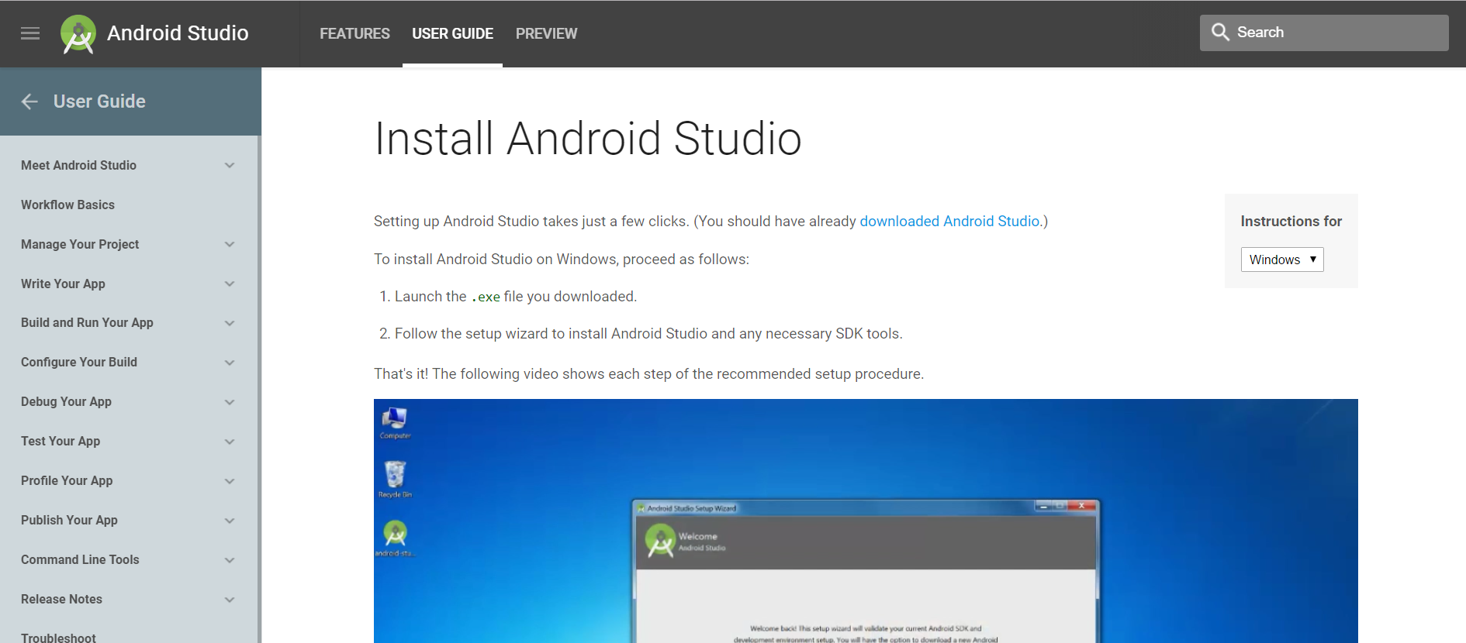
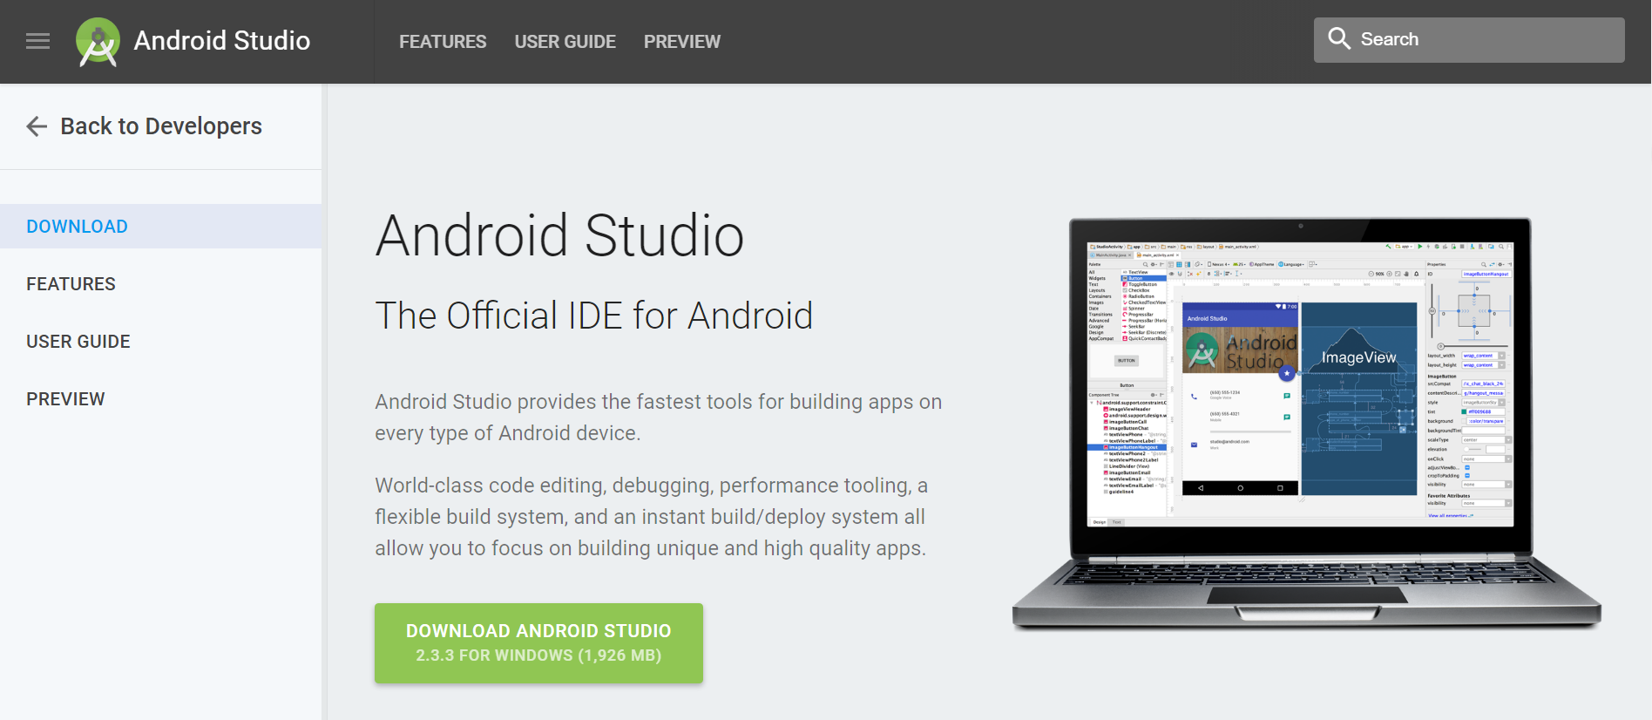
Configure the development environment
https://developer.android.com/studio/install.html
https://developer.android.com/studio/index.html
https://developer.android.com/studio/install
Notes:
Open this link and download the exe file to install the IDE. Then just follow the wizard steps.
Such file is only the IDE itself, you also need to download the Android SDK, compile tools and hardware debug tools.
All processes are done automatically.

Slide 4
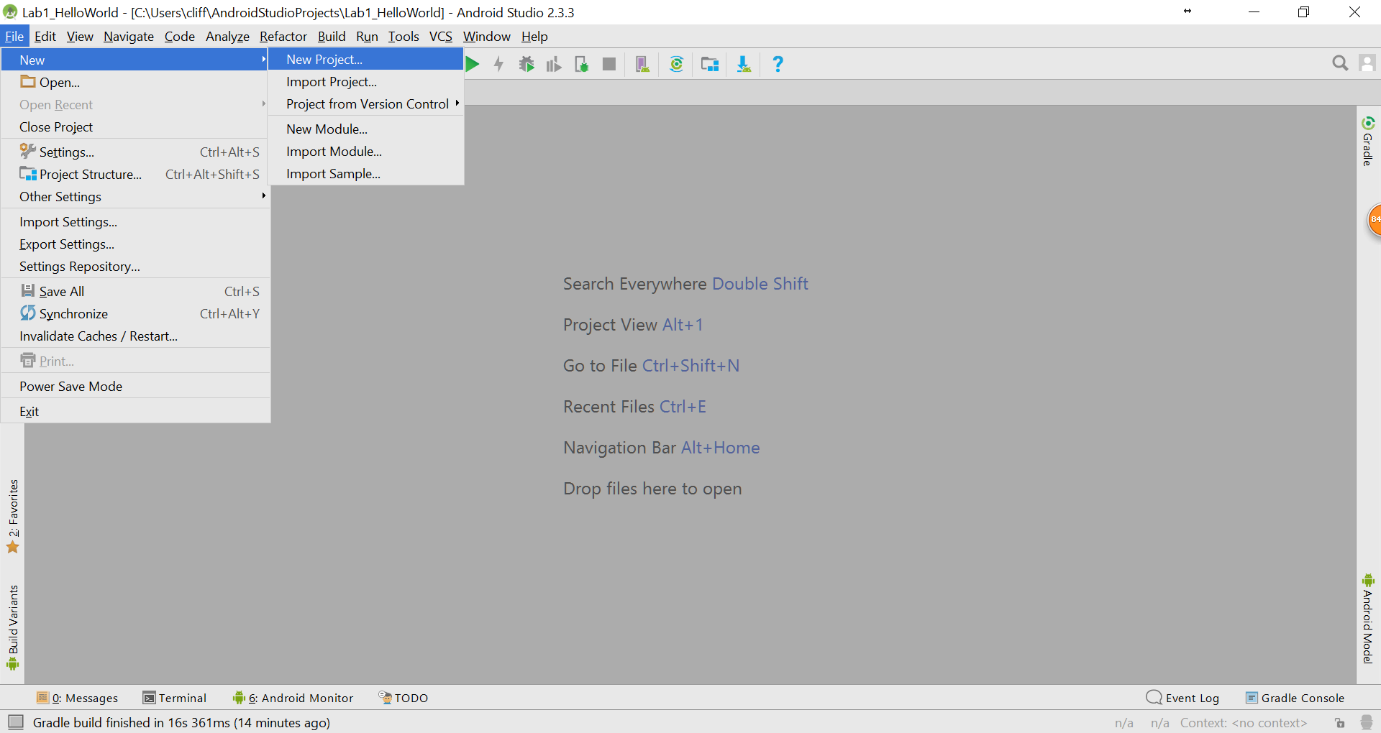
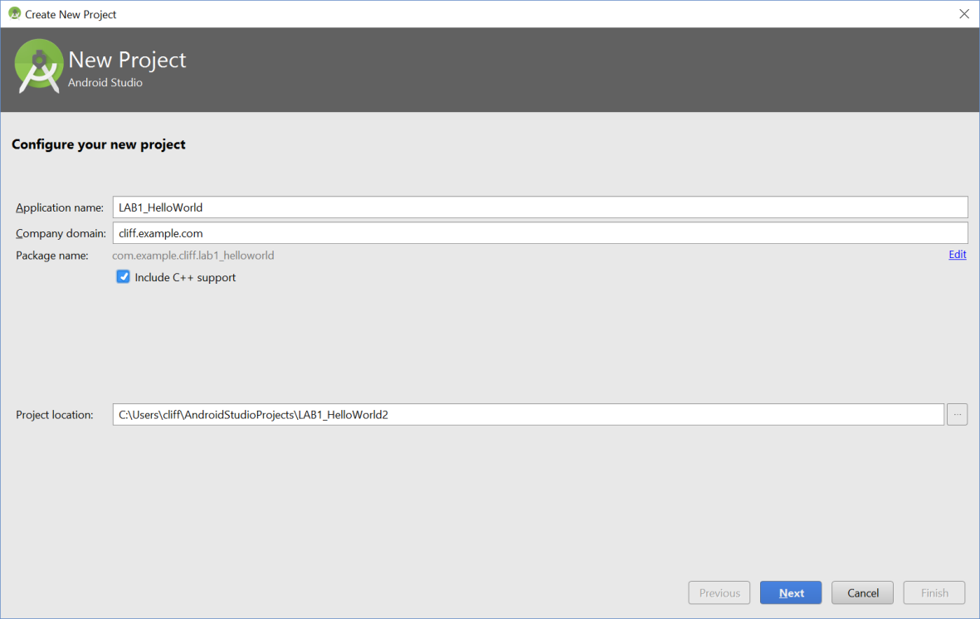
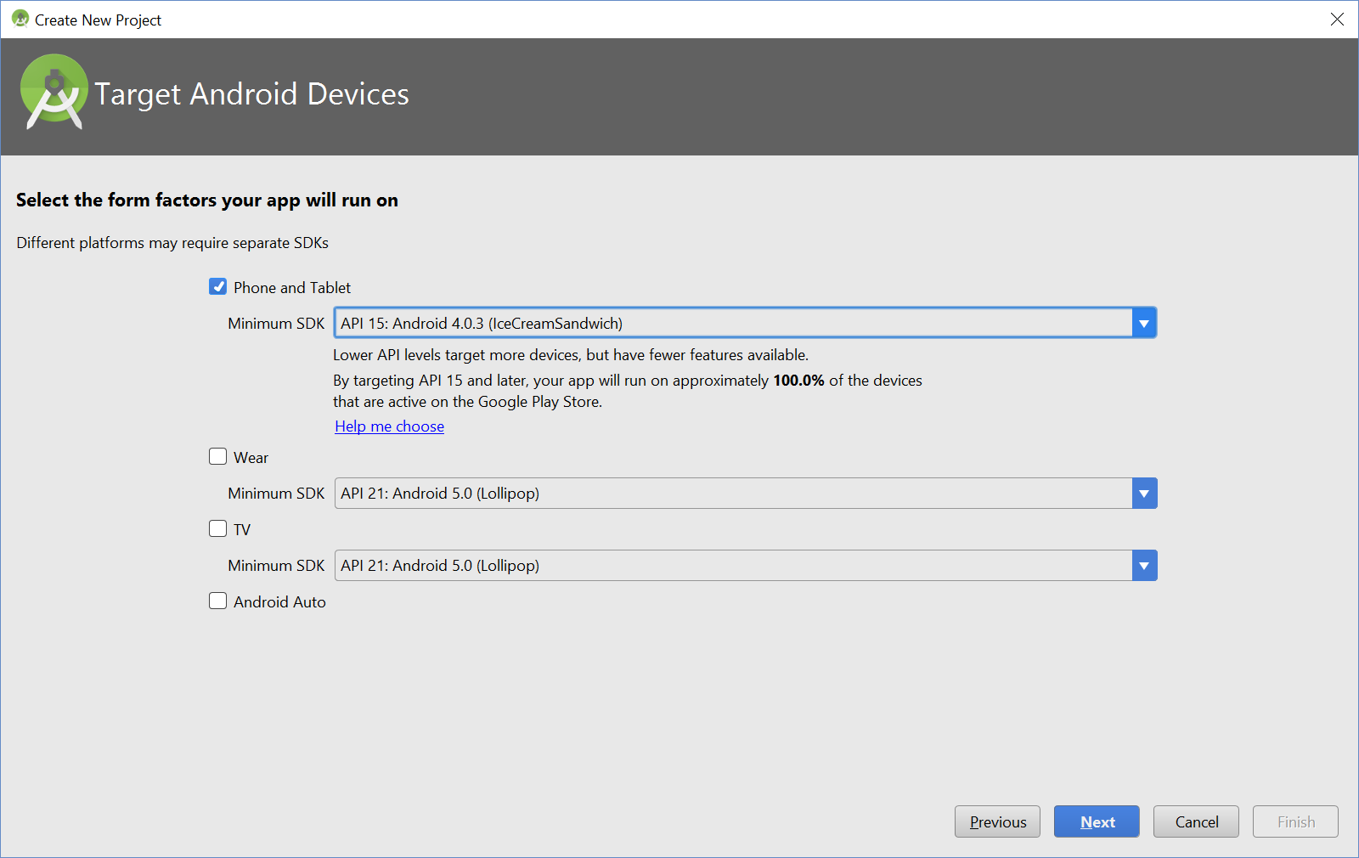
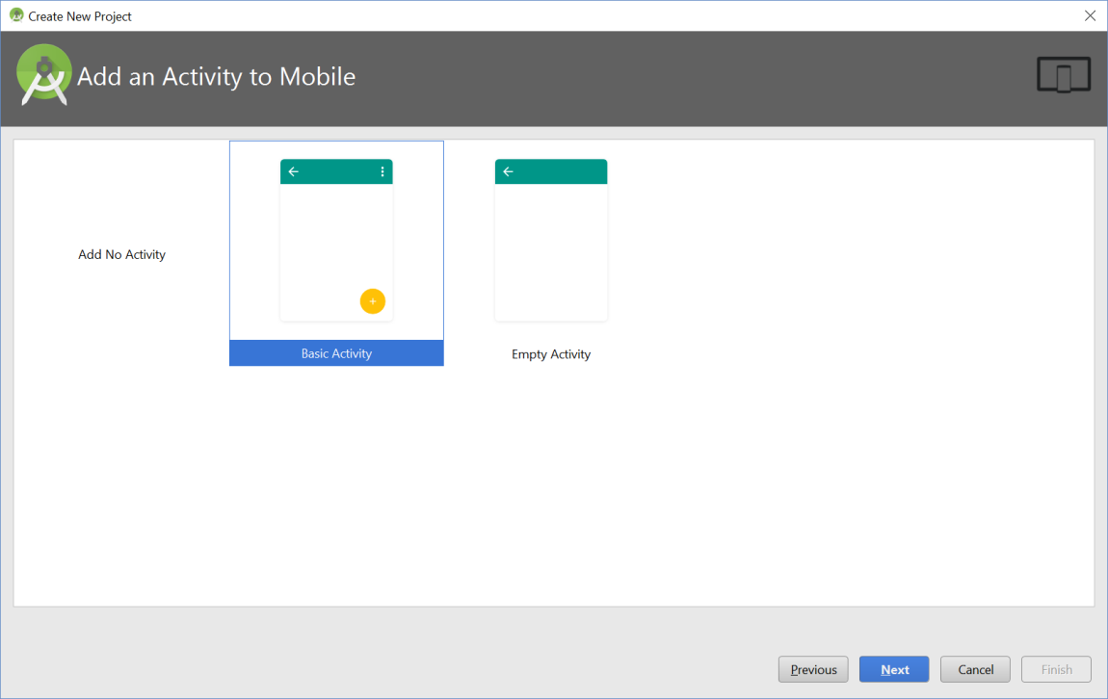
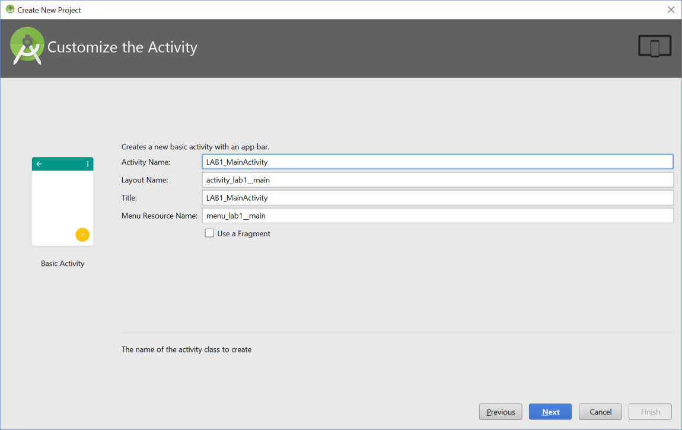
Configure the development environment
1. New a Project
Notes:
Just like many other IDEs.

Slide 5
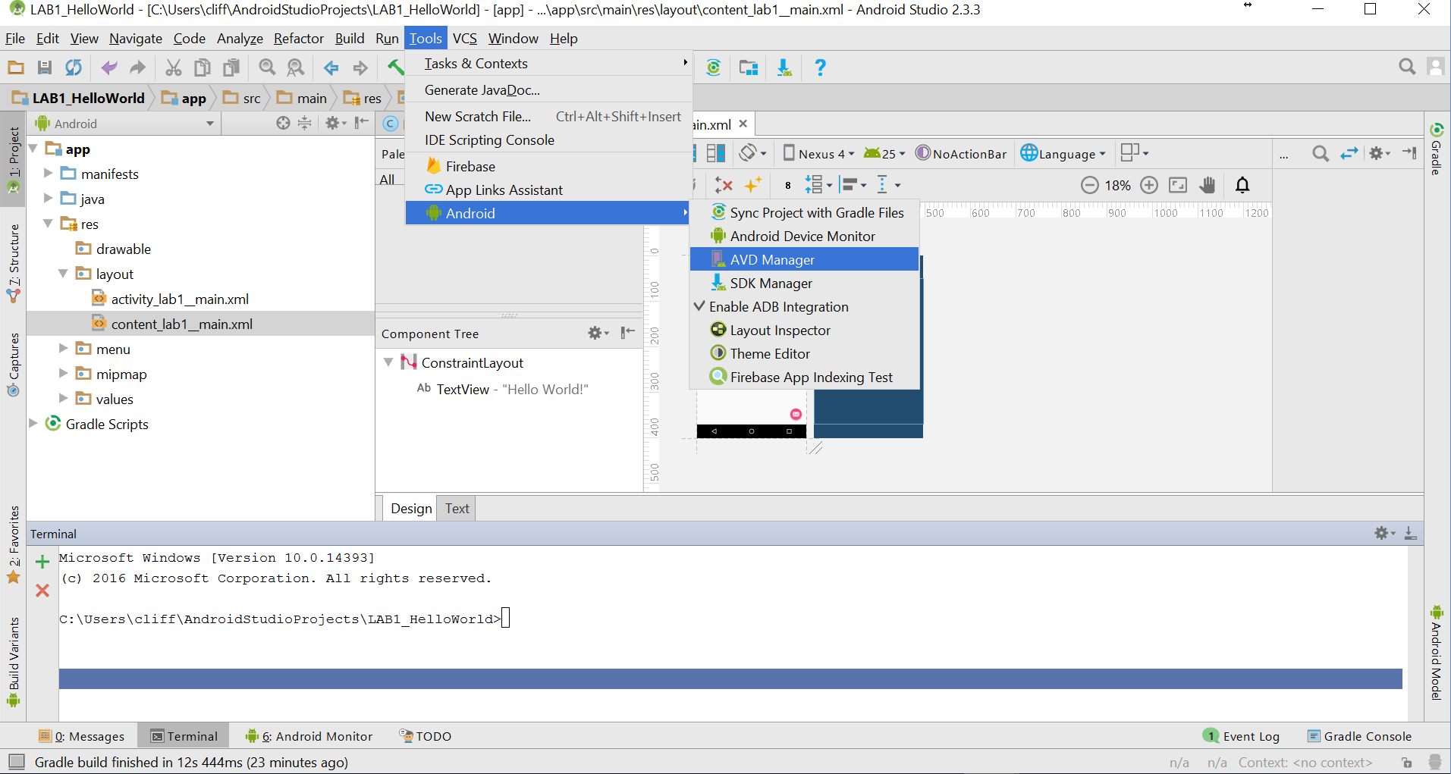
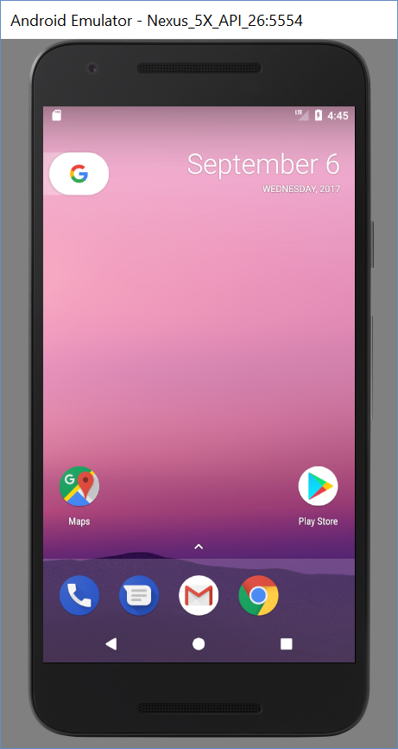

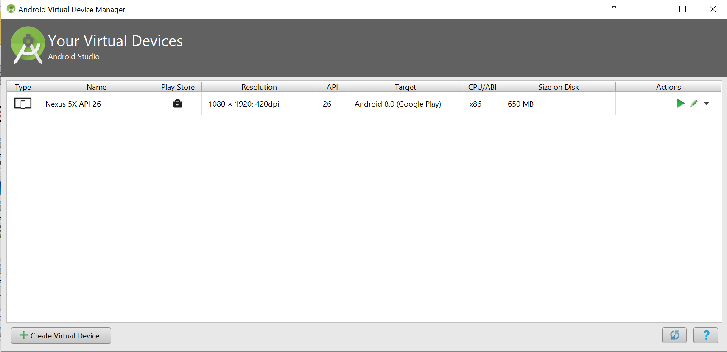
Configure the development environment
2. Start the Emulator
Notes:
Remember

Slide 6
Activity
An activity is a type of app component that provides a user interface.
The "main" activity is what starts when the user taps your app icon, but you can take the user straight into a different activity from other places, such as from a notification or even from a different app.

Slide 7
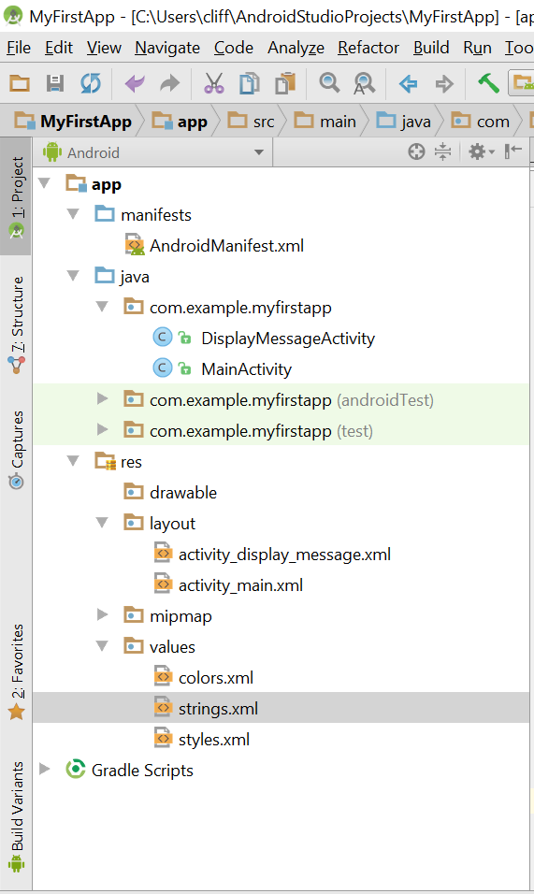
Android App development file structure
AndroidManifest.xml is a must file in every Android App. It locates at the root directory describing the location of different classes, data and starting file of the exposed components, i.e., activities, services, etc.
MainActivity.java is the default entrance to a project. It defines the major activity classes in the project.
res folder stores all the resource files, such as text, figures, icons.
res/layout stores all the layout files in displaying different components in the canvas.
res/values stores resource files’ information in .xml format.

Slide 8
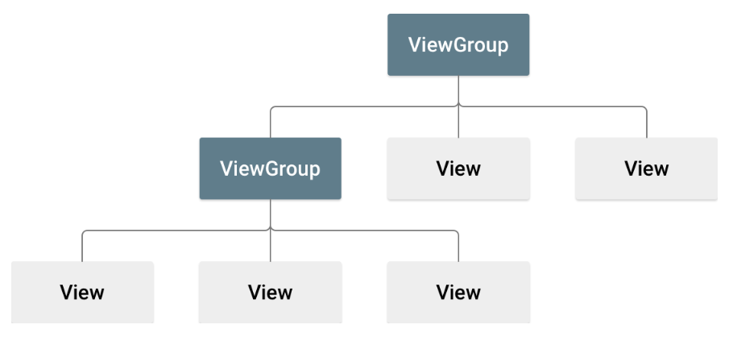
Build a simple user interface
The user interface for an Android app is built using a hierarchy of layouts (ViewGroup objects) and widgets (View objects). Layouts are invisible containers that control how its child views are positioned on the screen. Widgets are UI components such as buttons and text boxes.
Android user interface (UI) can be defined via:
XML vocabulary
Drag-and-dropping views
Notes:
Today we only introduce the one-level layout.

Slide 9
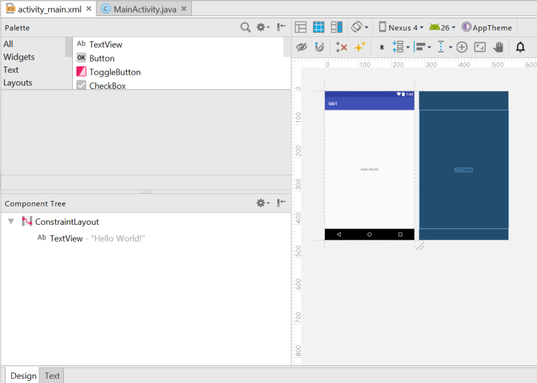
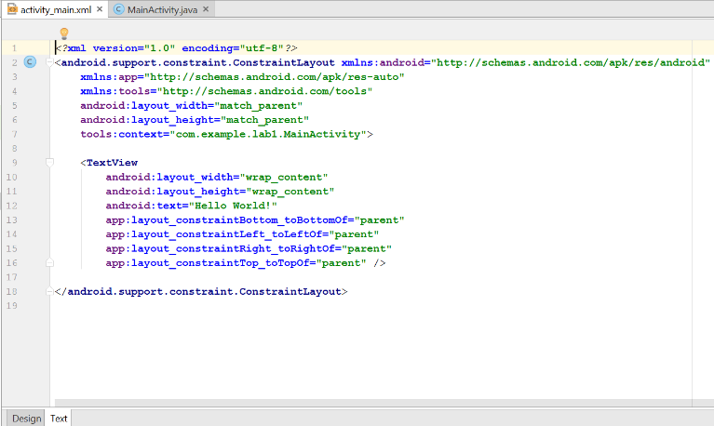
Create linear layout
In the Android Studio Project window, open app > res > layout > activity_main.xml.
In the layout editor, you are able to see design and text. Choose text, which means we use XML vocabulary to design the UI while not through drag-and-dropping views.

Slide 10
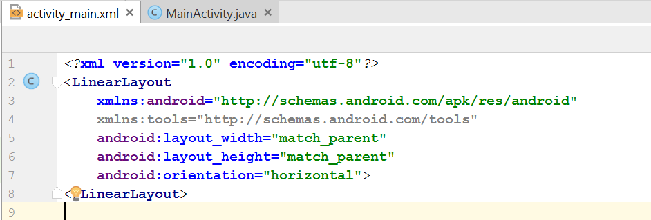
Create linear layout
LinearLayout is a subclass of ViewGroup, it sets the vertical view or horizontal view according to the attribute of android:orientation.
android:layout_width and android:layout_height are two requisite attributes for all views defining their size.
LinearLayout is the root view in the layout, hence the width and height should be set to “match_parent” such that apps can fill the whole display areas to match their parents’ size.

Slide 11
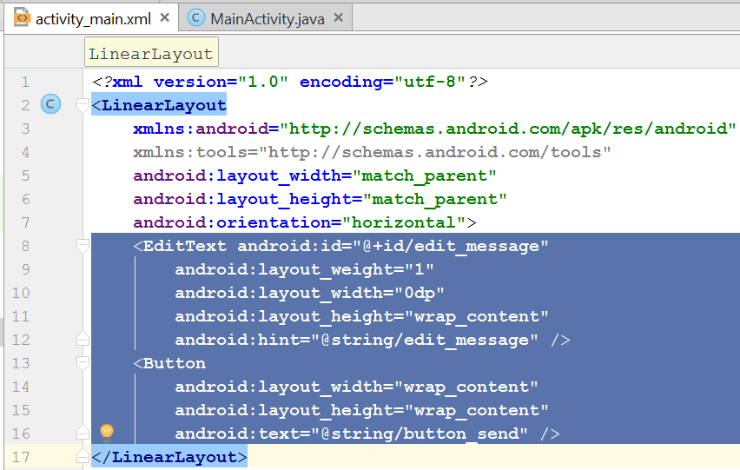
Add text field and button
In the element of <LinearLayout> of activity_main.xml add <EditText> element and <Button> element.
<Edit Text> element is used in the input text box which prompt users to input a message.
<Button> is a button, after which is clicked an activity will be triggered.

Slide 12
Attributes in LinearLayout
android:id --- the unique ID assigned by View, which can reference objects, such as fetching and handling objects.
@ sign is required when referencing any resource objects from XML followed by input resource type, slash (/) and resource name (edit_message)
Plus sign (+) is only needed for the first time we defining resource ID. A new resource ID is created referencing <EditText> in R.java file in Project. Once declared, other references to this ID do not require using plus sign (+)
android:layout_width and android:layout_heightelement
"wrap_content“, dynamically adjust the display the size of View.
"match_parent“, <EditText> fill all display screen, as it matches its paraents’ LinearLayout size.
android:hint is the default displaying strings when the input text field is empty.
It references strings from other file while not a hard coding string. A plus sign (+) is not necessary, as it references a specific resource (not just an identifier).

Slide 13
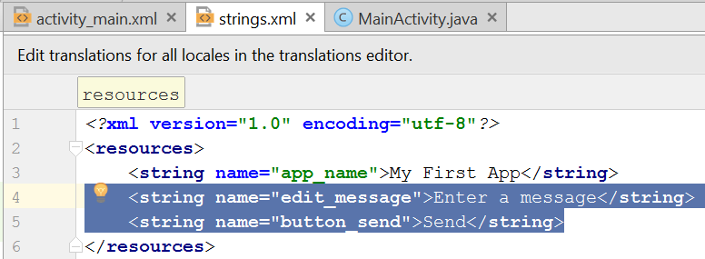
Add string resource
In the Project window, open res > values > strings.xml.
Two more new strings needed to be added in the string resource file, “edit_message” and “button_send”.

Slide 14
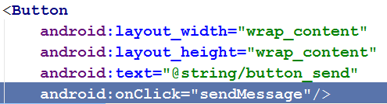
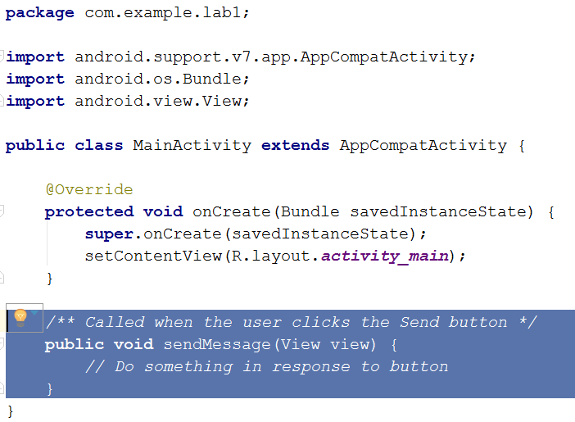
Start an activity --- add a send button
In res > layout > activity_main.xml file，add android:onClick attribute to <Button> element. When user click send button, system will call Activity’s sendMessage() method.
Add the sendMessage() method stub in the file app > java >com.example.myfirstapp > MainActivity.java as shown on the right. This method should be in accordance with method specified by android:onClick attribute. Specifically,
Public access
A void return value
A View as the only parameter (it is the View object that was clicked)

Slide 15
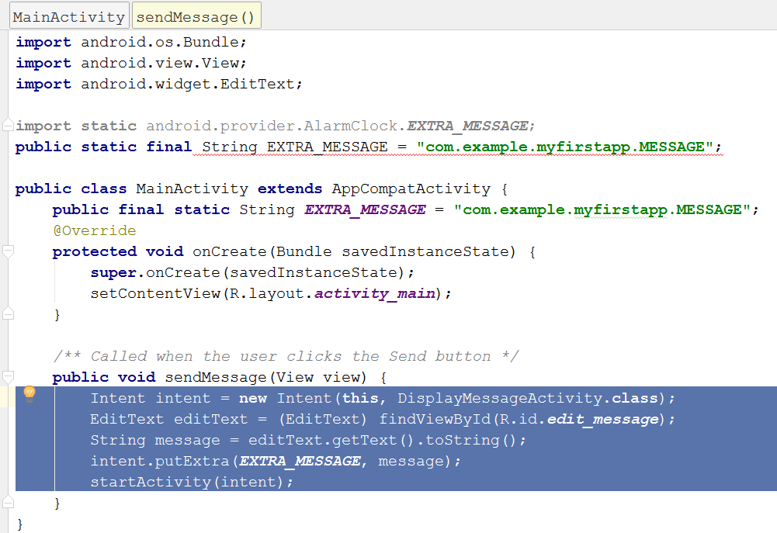
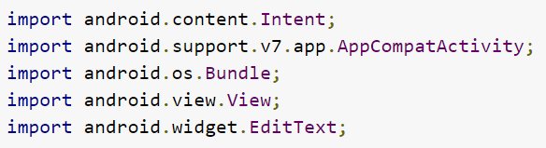
Build an Intent
An Intent is an object that provides runtime binding between separate components, such as two activities. The Intent represents an app’s “intent to do something”.
Press Alt + Enter (or Option + Return on Mac). Your imports should end up as the following:

Slide 16
Build an Intent
The Intent constructor takes two parameters:
A Context as its first parameter (this is used because the Activity class is a subclass of Context)
The Class of the app component to which the system should deliver the Intent (in this case, the activity that should be started).
The putExtra() method adds the EditText's value to the intent. An Intent can carry data types as key-value pairs called extras. Your key is a public constant EXTRA_MESSAGE because the next activity uses the key to retrieve the text value. It's a good practice to define keys for intent extras using your app's package name as a prefix. This ensures the keys are unique, in case your app interacts with other apps.
The startActivity() method starts an instance of the DisplayMessageActivity specified by the Intent. Now you need to create that class.

Slide 17
Start another activity
In the Project window, right-click the app folder and select New > Activity > Empty Activity.
In the Configure Activity window, enter "DisplayMessageActivity" for Activity Name and click Finish (leave all other properties set to the defaults).
Android Studio automatically does three things:
Creates the DisplayMessageActivity.java file.
Creates the corresponding activity_display_message.xml layout file.
Adds the required <activity> element in AndroidManifest.xml.

Slide 18
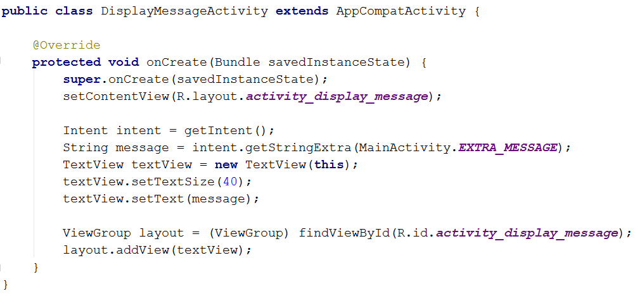
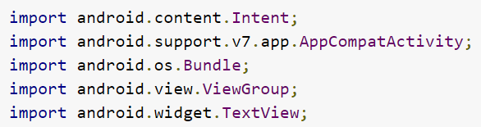
Display the Message
1. In DisplayMessageActivity.java, fill the codes above in onCreate() method.
2. Press Alt + Enter (or Option + Return on Mac) to import the missing library.

Slide 19
Display the Message
Calling getIntent() collect the intent from starting Activity. No matter how users are navigated to the destination, every Activity is called by one Intent. Calling getStringExtra() will retrieve the information from the first Activity.
You can create TextView and set its size and display message.
TextView is added to the layout of R.id.activity_display_message identifier, which will be mapped to ViewGroup, as it is the super class of all layout and includes addView() method.
Add android:id="@+id/activity_display_message” to the layout activity_display_message.xml.

Slide 20
Task 1
Run The App and Display
“Hello World!!!”

Slide 21
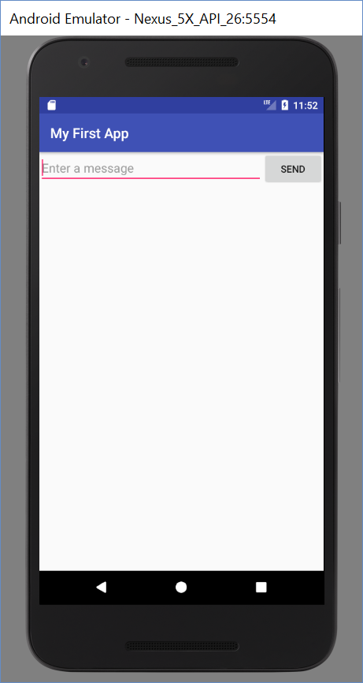
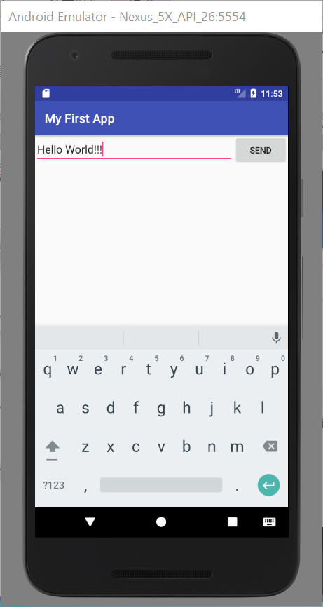
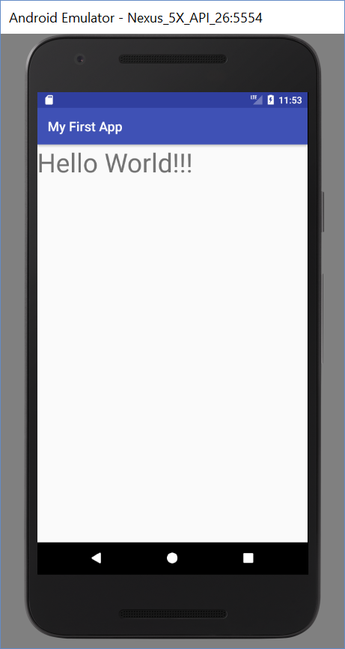
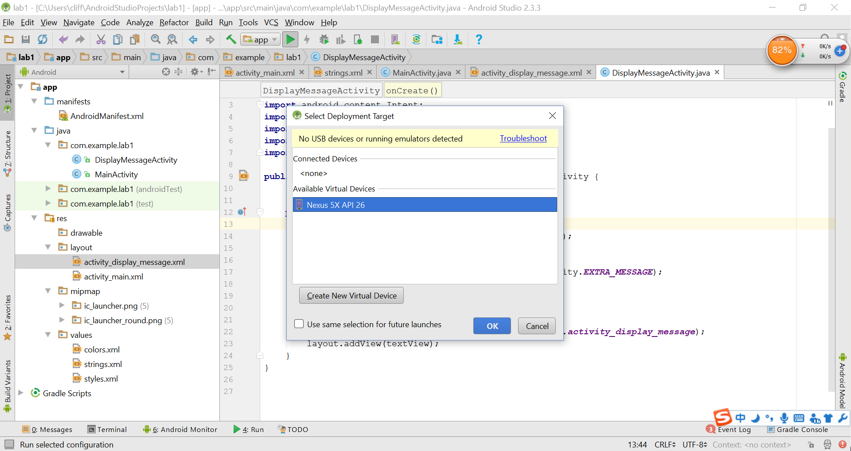
Run the App
1.
2.
3.
4.

Slide 22
Task 2 (Bonus)
Add a “Start App” Button and Run the App

Slide 23
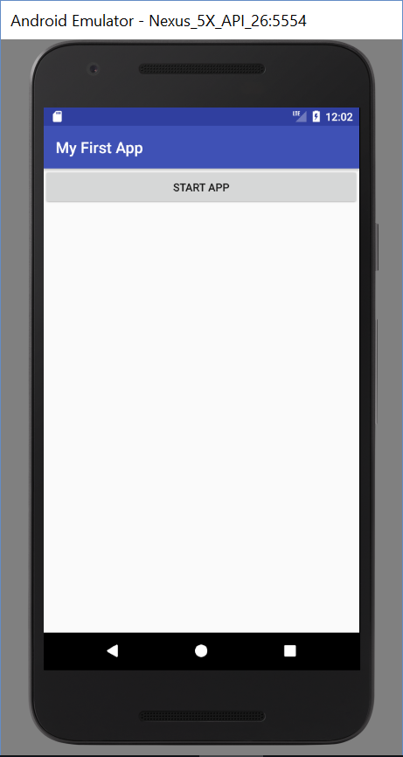
1.
Click
2.
3.
4.

Slide 24
Requirement
Please capture and upload the screenshots of your Android app developed during the lab class:
Task 1: Develop and run the "Hello World".
Task 2 (Bonus): Add a "Start App" button and run the app.

Slide 25
Reference
https://developer.android.com/training/basics/firstapp/index.html (English)
http://hukai.me/android-training-course-in-chinese/basics/firstapp/creating-project.html (Chinese)

Slide 26
THANK YOU!

